Slide 1
A Need for Speed
Accelerating Your Math with Vectorization and NumPy
Kyle Kotowick, Ph.D.
PyCon Canada, 2019
https://github.com/kkotowick/need-for-speed

Slide 2


Slide 3

Notes:
I freelance through Toptal.

Slide 4
Python is slow?

Slide 5
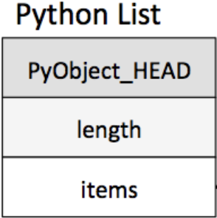
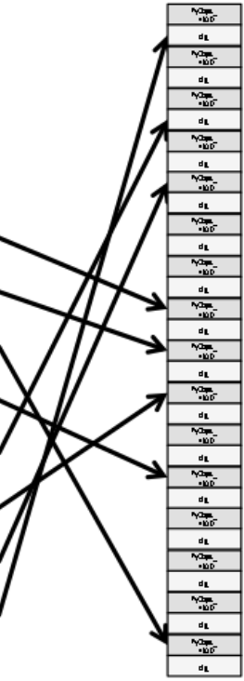
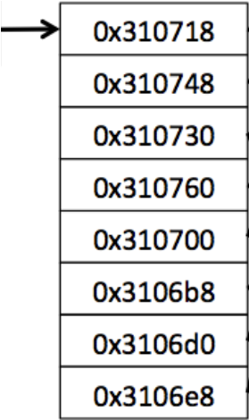
Credit: medium.com – Guru Prasad

Slide 6
Retrieve address of items array
Retrieve address of item N
Retrieve object metadata of item N
Determine object type and proper operation
Retrieve content of item N
Run the operation
Repeat steps 2 – 6 for every item
1.
2.
3.
5.

Slide 7
Pros:
Resize list without copying objects
Any mix of object types
Can modify object type of any element without affecting others
Cons:
Slow
No pre-allocation
One element at a time => bad for interpreter

Slide 8
Python Examples

Slide 9
NumPy

Slide 10
1990 Python first release
1995 matrix-sig
Numeric
2006 NumPy
~2000 Numarray

Slide 11
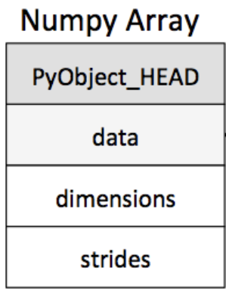
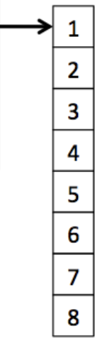
Credit: medium.com – Guru Prasad

Slide 12
Retrieve address of data array
Calculate address range of interest
Retrieve data
Run the operation
3.
1.
2.

Slide 13
Pros:
Pre-allocate array
Access all relevant data at once
One interpreter action
Cons:
Single data type
No dynamic sizing
Compatibility with other libraries

Slide 14
NumPy Examples

Slide 15
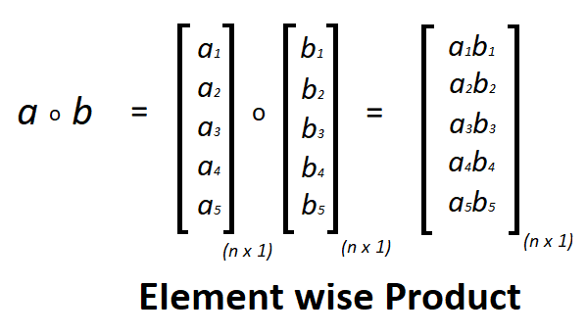
Credit: geeksforgeeks.org

Slide 16
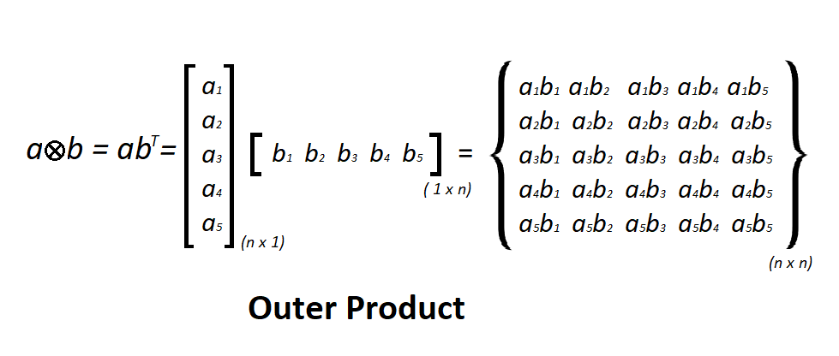
Credit: geeksforgeeks.org

Slide 17
Thank you!
Kyle Kotowick, Ph.D.
kotowick@imperative.systems

